Slide 1
IPC VISTA - Toronto 2017
A Case Study
Margarita Sweeney-Baird
Founder of Inclusive Skating in 2010

Slide 2
Inclusive Skating & Special Olympics
Kennedy Scholar at Harvard 1987 – some early work then but no action taken by UK NISA so no disabled ice skating program
Inclusive Skating founded in 2010, registered charity in 2011
IS & SOGB Nationals since 2012
10 British skaters competed at WWG 2017

Slide 3
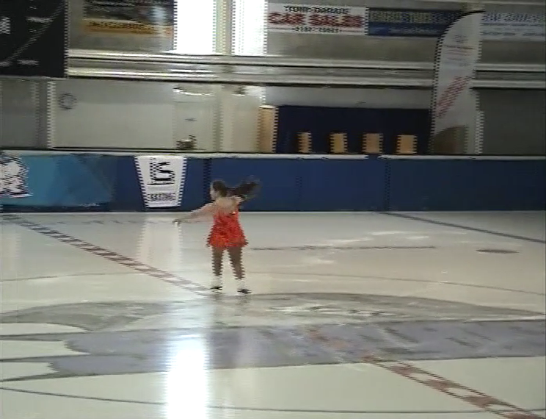
Event Development Club & Community
(Top Down) (same policies!)

Slide 4
British Inclusive Skating Championships 2017
Impairment compensation ranges from 0% to 95% - Goal achieved – all disabilities included!

Slide 5
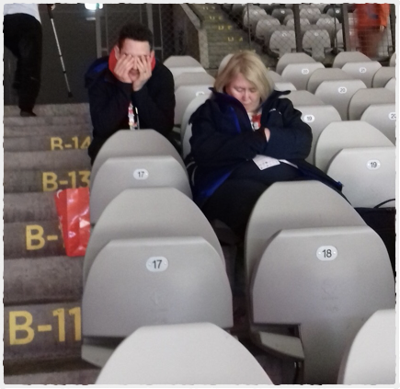
Accreditation - Event
Inclusive skaters own carers are allowed to look after them during competition
Able bodied events don't allow carers accreditation at competition venue
Disability events e.g. Special Olympics, have independent carers and separation from families

Slide 6
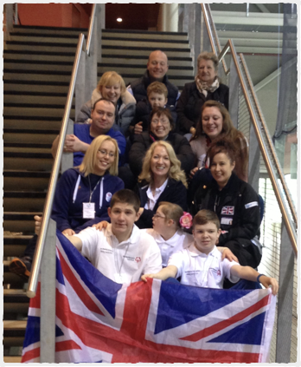
Consequences of IS Accreditation Policy
Inclusive skaters cared for by their own family and carers at all times
All carers can access all skating areas
Average 2 carers per skater
Events become a holiday
A high percentage of carers are disabled and socio-economically disadvantaged
Families and carers = community.
Very Safe for skaters!

Slide 7
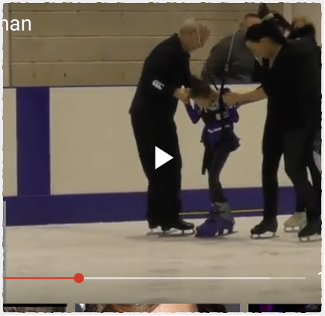
Inclusive Skating Facilitation, Rules & Events
Rule adjustment and new competitions
E.g. Harness, frames and facilitators
Facilitation - Whatever is necessary based on individual assessed need
Classification Handbook, 4th Ed. Gives examples
Inclusive Skating Technical Handbook, 2nd Edition provides event structure
Incorporate disability specific events too!

Slide 8
Inclusive Skating – Inclusion for all
All impairments classified & unified (ADHD, mentally ill included too)
Accreditation, Facilitation & Rule Adjustment – 3 key policies provide a safe system that skaters and carers/ parents feel comfortable in!
Functional impact as a percentage (WPI%) + added to average score
Applied to levels – medals awarded to new skaters – encouraging and used for Special Olympic selection using participative model
Amalgamate levels to give Championship results - since 2015
System can apply to many sports, e.g. gymnastics etc.
Disability Specific results, e.g British Blind Sport (B1, etc ) – Low cost and maximise the available opportunities!

Slide 9
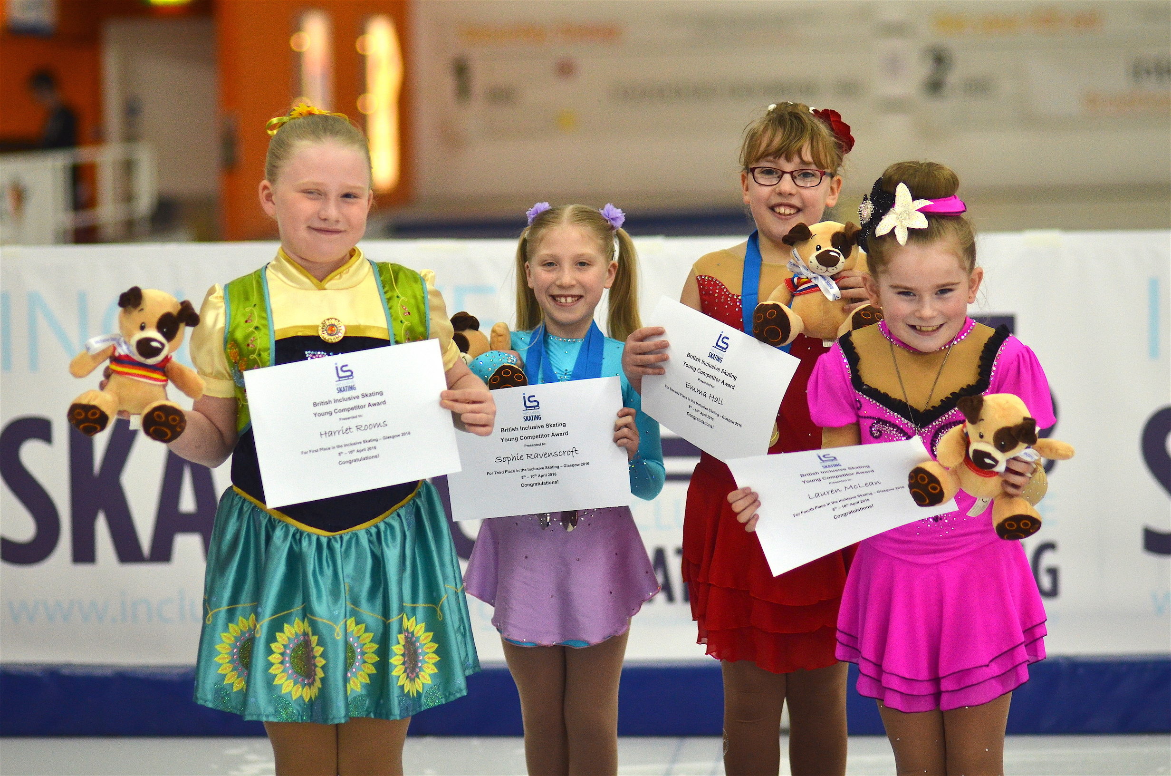
Majority of the skaters had a genetic condition

Slide 10
Structure of Inclusive Skating & Disabled Sport
(Genetic Disorders disadvantaged)
INCLUSIVE SKATING
100% of disabilities
& able-bodied
(Mentally ill included)
INTELLECTUAL
Only ONE disability
15% of disabled
PARALYMPIC
Only ONE disability
Estimate
1% of disabled
(mostly physical, B1, B2, B3,
a few intellectual)
BLIND
Only ONE disability
10% of disabled
DEAF
Only ONE disability
8% of disabled
GENETIC DISORDERS
All disabilities
Estimate
<75% of disabled
3.8 million chilfdren
4% of all children
Special Olympics
INAS
Blind Sport
Deaflympics
? NEW ?
Inclusive Sport for Genes +
Inclusive Olympics

